Slide 1

Bike Sharing Dataset Analysis
ANLY 500:
ANALYTICS I: PRINCIPLES & APPLICATIONS
Project By :
Neeraj Gupta
Tripti Mishra

Slide 2
Contents
Introduction
Problem Statement
Dataset Description
Data Analysis and Findings
Challenges
Conclusion of Analysis
Future work

Slide 3
Introduction
Business Case
We are using the recorded data of the bike trips which were used in Bay area of San Francisco From August 2014 to August 2015.
The objective of this project is to determine the peak hours, days, months in which bikes are mostly occupied by the subscribers/ customers and which stations are popular among bike riders.
We have chosen this project as it provides insights into the factors which affects the bike sharing on basis of location, days or trip duration.
We can use this analysis to predict future usage and increasing the rental count of these bikes.
To increase the effectiveness and use of these services and thereby attract more users

Slide 4
Problem Statements
Unbalanced stations
Bike sharing programs usually have a problem of unbalanced stations where the number of trips from these stations is higher than the number of trips to these stations (or vice versa).
Non-uniform usage of bicycles
Some stations are very popular with many rents, while some have only few rents. Because of that in general bicycles at popular stations tend to be used significantly more often than bicycles at not popular stations. A not uniform usage of bicycles leads to a need of bringing heavily used bicycles often to a workshop, while there are some bicycles almost new and used only a few times.
The goal is to analyze the data and see if there is a possibility to suggest bicycle transfers in a way to balance bicycle usage.

Slide 5
Dataset Description
The data is from an "OPEN DATA" source retrieved from https://github.com/udacity/data-analyst/find/master
We have used 2 CSV data files : 201508_trip_data.csv, 201508_station_data.csv
Bay Area Bike Share started their operation in August 2013 in San Francisco Bay Area with 700 bicycles in 70 stations. The bike stations are available 24 X 7.
We have selected the Year 2 Data from Sep 2014 to Aug 2015

Slide 6
Exploratory Data Analysis
DATA SUMMARY

Slide 7
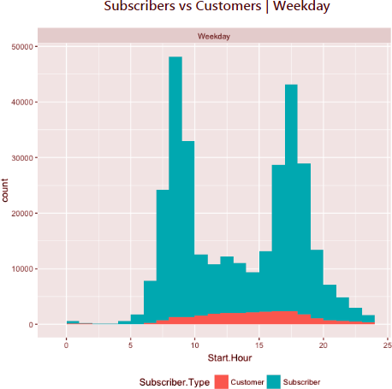
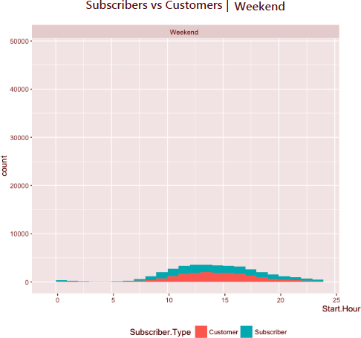
Exploratory Data Analysis
TIME BASED USAGE

Slide 8
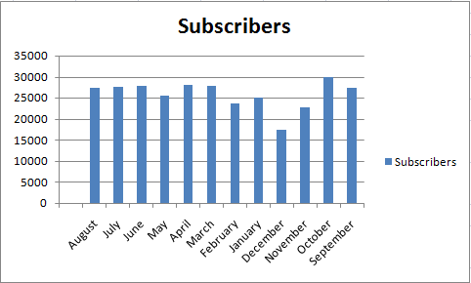
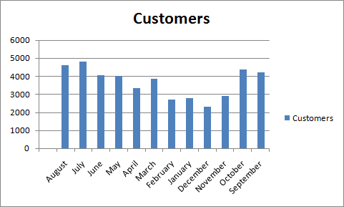
Exploratory Data Analysis
RENTAL INFORMATION

Slide 9
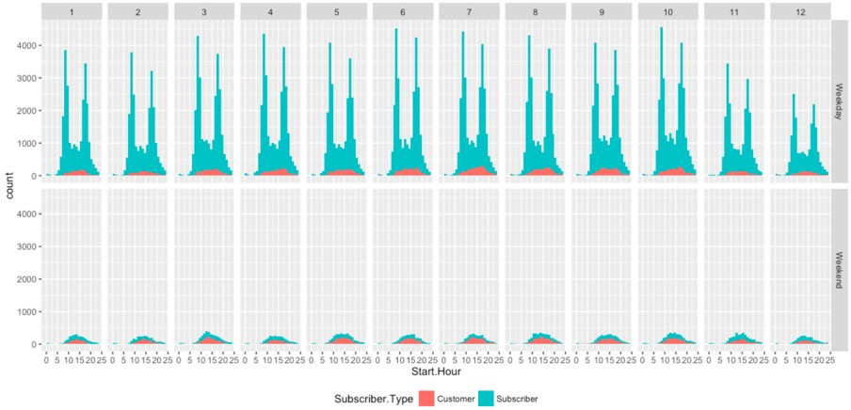
Exploratory Data Analysis
MONTH-TO-MONTH USAGE

Slide 10
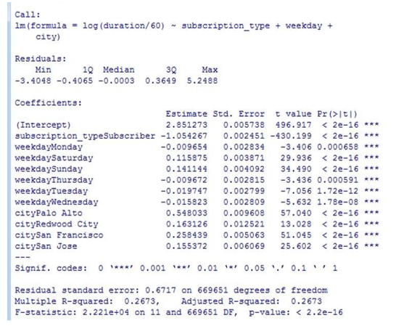
Model Creation using Linear Regression
We tried using regression to develop a model, but it did not provide any useful information. The R-square is only 26% which means it can only predict the variability in the duration of bike usage per trip only 26% of times.
We tried multiple models but the r-square kept decreasing and therefore we decided to not use regression for our analysis.

Slide 11
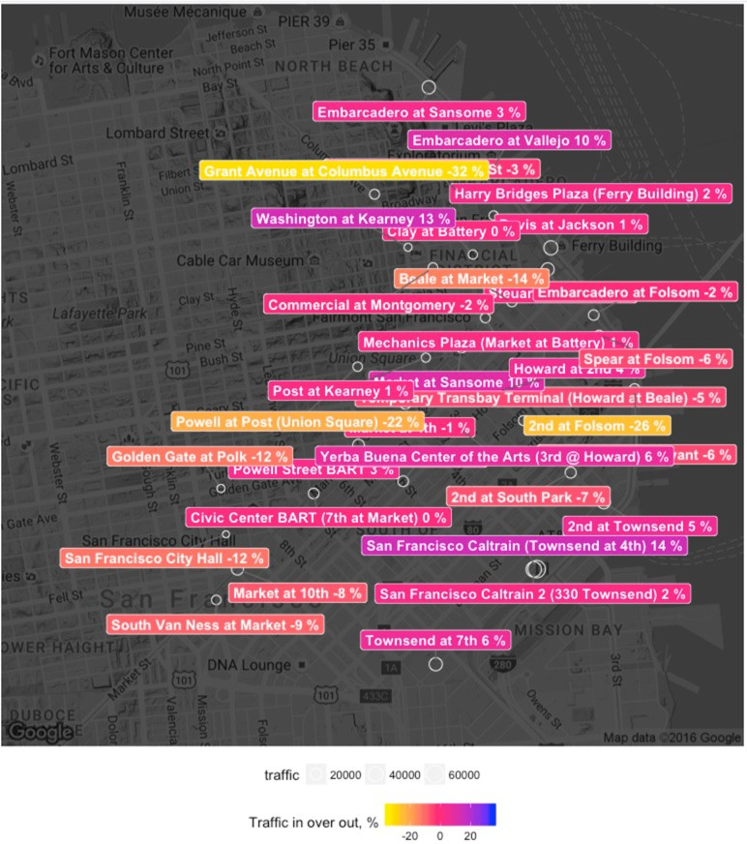
FINDINGS: Stations in San Francisco
Blue/ Purple : Stations with more bike arrivals than departures
Yellow: Stations with more bike departures than arrivals

Slide 12
FINDINGS: STATIONS IN SAN FRANCISCO
Blue/ Purple : Stations with more bike arrivals than departures
Yellow: Stations with more bike departures than arrivals

Slide 13
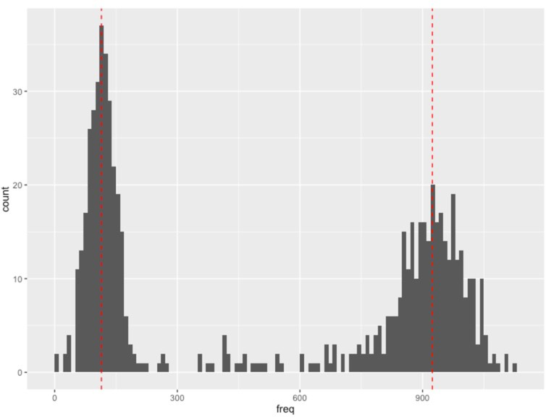
FINDINGS: BIKE USAGE

Slide 14
Conclusion
Recommendations
Terminal | Station | Recommendation
10 | San Jose City Hall | Bring 1 heavily used bikes
11 | MLK Library | Bring 2 heavily used bikes
16 | SJSU - San Salvador at 9th | Take off: 181
2 | San Jose Diridon Caltrain Station | Take off: 213, 165, 663
22 | Redwood City Caltrain Station | Bring 1 heavily used bikes
25 | Stanford in Redwood City | Take off: 126, 196
26 | Redwood City Medical Center | Bring 1 heavily used bikes
27 | Mountain View City Hall | Take off: 35, 139
Based on our findings, we recommend the below transfers to make the distribution of bicycle usage a more uniform or normal rather than bimodal. To do it we believe that bicycles which were extensively used in areas with high traffic should be moved to stations with low traffic, while bicycles which are almost new should be moved from stations with low traffic to stations with high traffic. Moving bicycles is also a cost so we believe that the right way to do this transfer is to do it along the regular bicycle transfer caused by imbalanced stations usage.

Slide 15
THANK YOU !

